Slide 1
Project 8 AI Chatbot for Mental Health Support Develop a native AI chatbot app for mental health assistance. Chatbot-based mental health support Mood tracking and journaling Emergency contact feature
Team 8
Ishan Tripathi IIB2024038
Hardik Rana IIB2024039
Pranathi Kotha IIB2024044
Himansh Arora IIB2024025

Slide 2
*INSERT AI IMAGES*

Slide 3
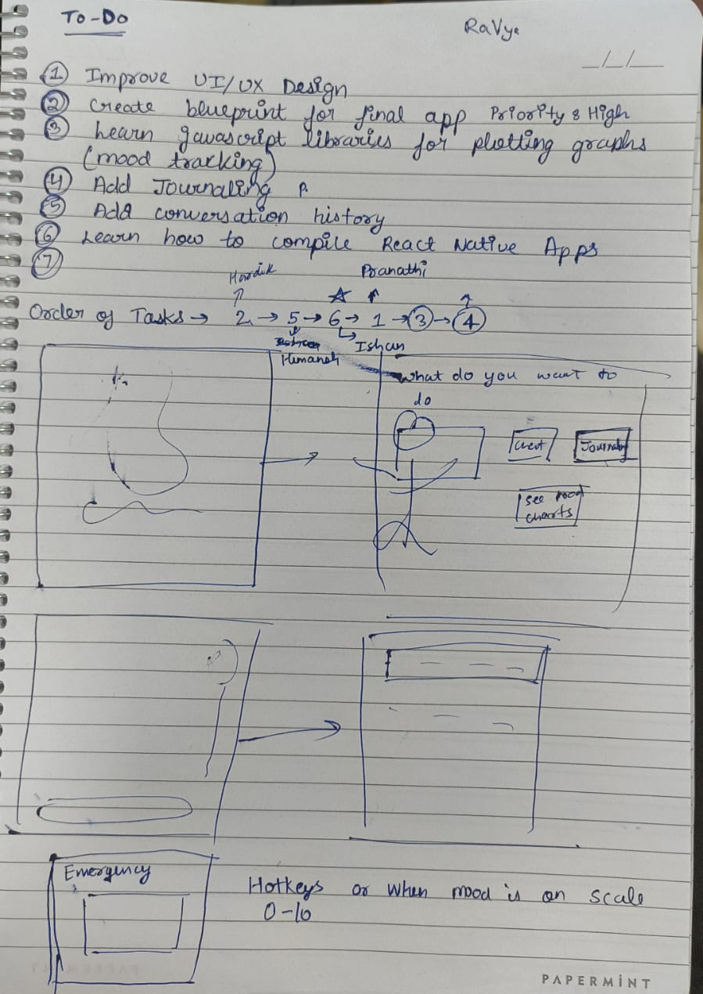

Slide 4
